Slide 1
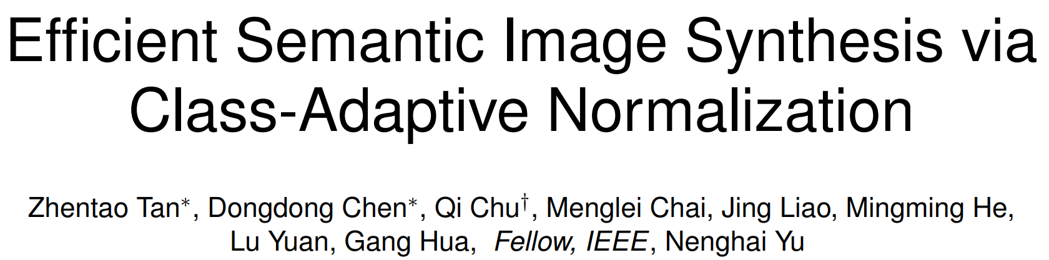
Published in PAMI, in April 2021
Jeonbuk National University, Korea
Multimedia Lab Under Prof. Park and Prof. Yoon
Mingle Xu
2021 June 11

Slide 2
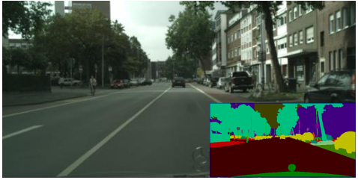
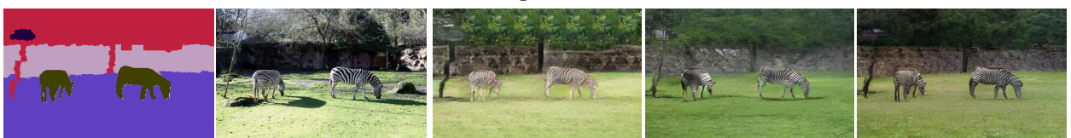
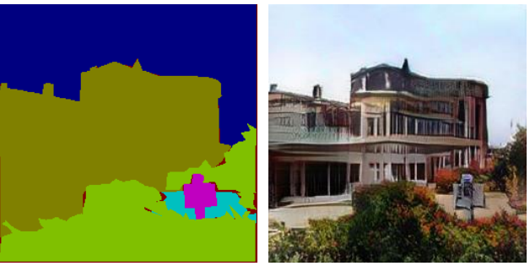
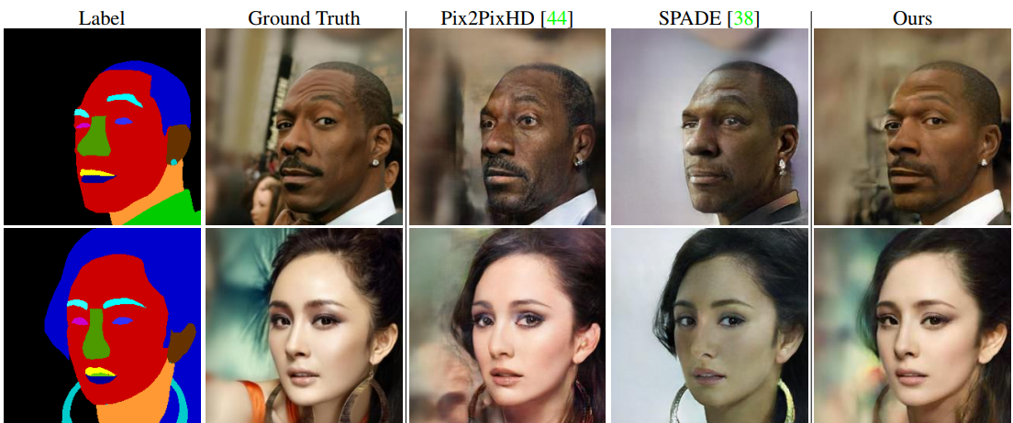
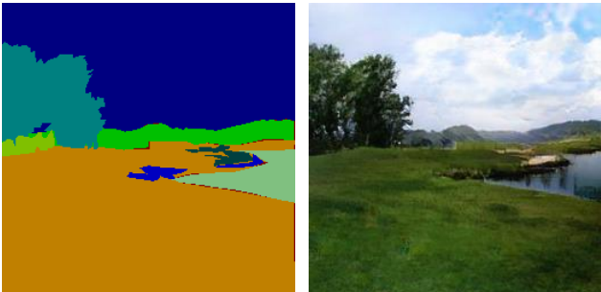
Semantic Image Synthesis
Semantic segmentation -> realistic image
Applications
Cityscapes
COCO-stuff
ADE20k
Landscapes
Face with makeups
Image manipulation
Change semantic label
Change style for label

Slide 3
How to use the semantic segmentation?

Slide 4
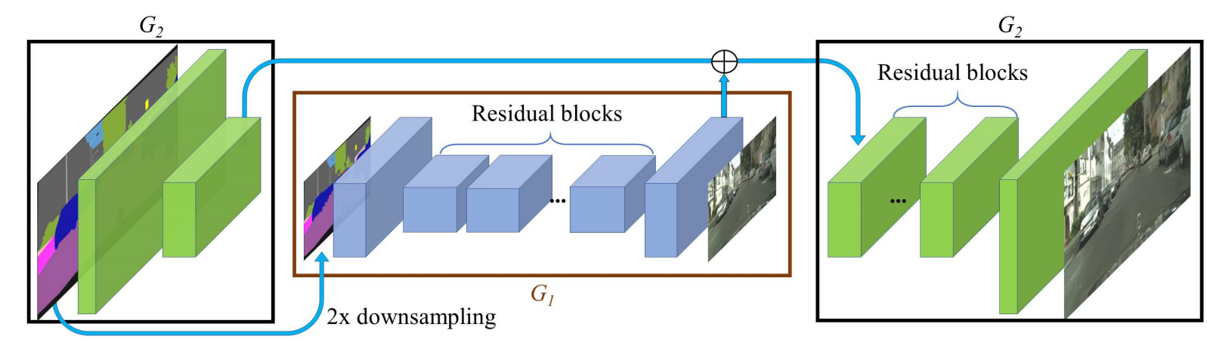
Related Work: pix2pixHD
Down sampling (conv) + residual blocks + up sampling (deconv)

Slide 5
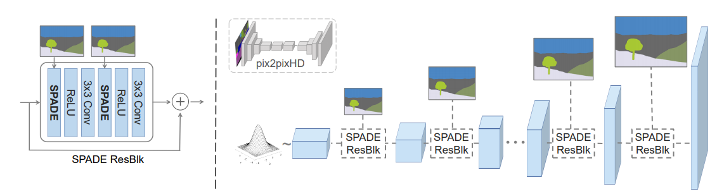
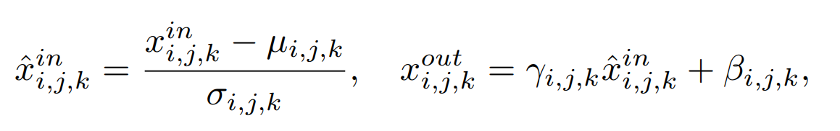
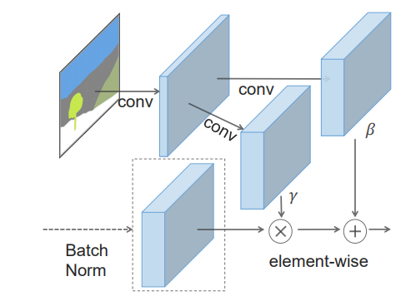
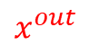
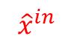
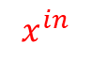
Related Work: SPADE
$$x^{in}$$
$$x^{out}$$
$${\hat{x}}^{in}$$

Slide 6
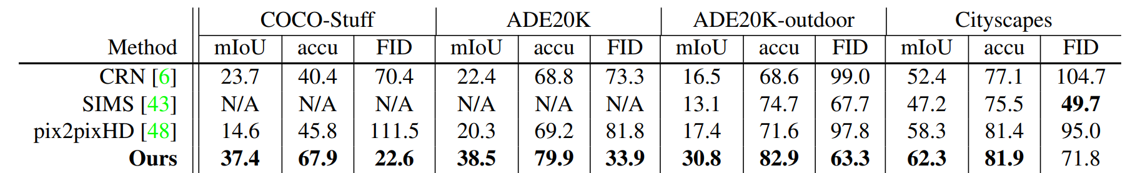
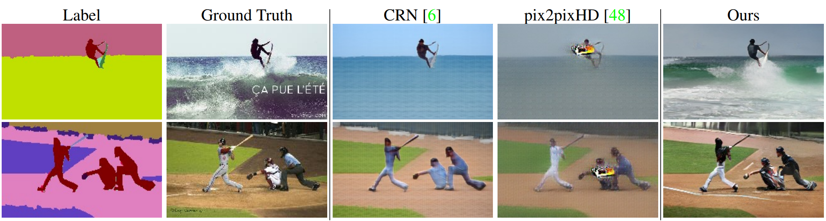
Related Work: SPADE and its Restuls
Much better results
Higher performance
Simper architecture with little parameters and computation.
But why?

Slide 7
Analyze and explain the SPADE.
Then make it better.

Slide 8
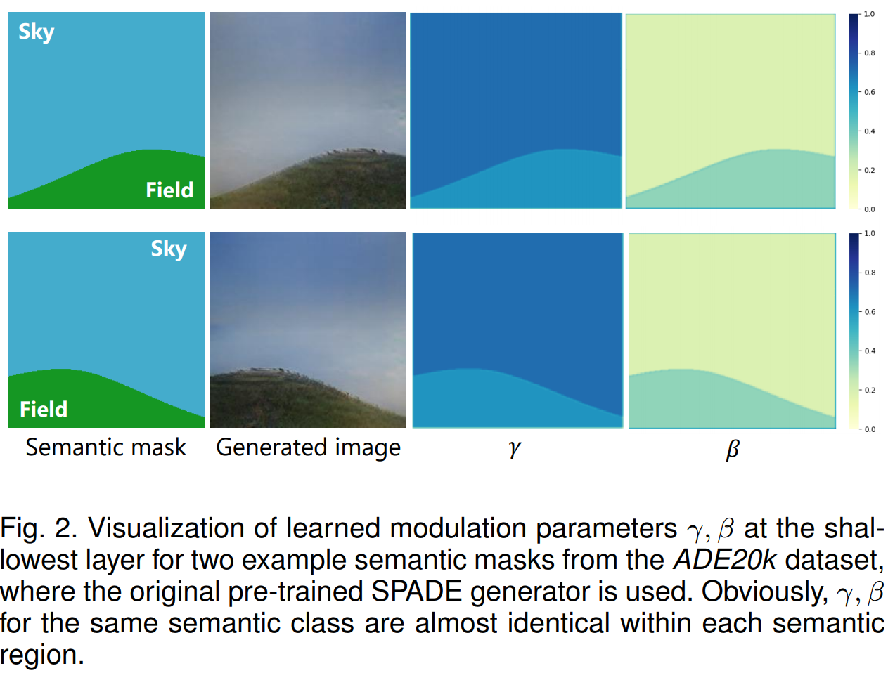
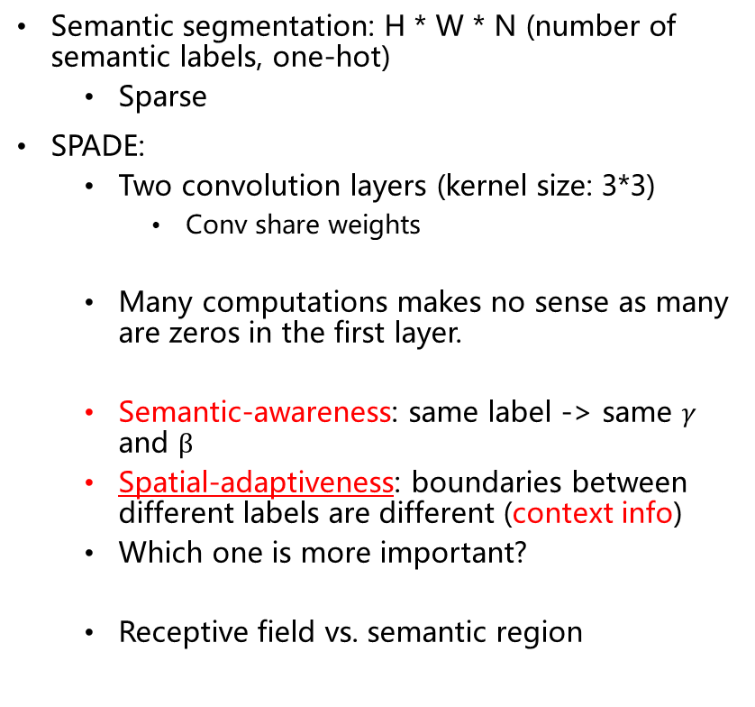

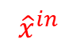

Revisit SPADE
Semantic segmentation: H * W * N (number of semantic labels, one-hot)
Sparse
SPADE:
Two convolution layers (kernel size: 3*3)
Conv share weights
Many computations makes no sense as many are zeros in the first layer.
Semantic-awareness: same label -> same $γ$ and $β$
Spatial-adaptiveness: boundaries between different labels are different (context info)
Which one is more important?
Receptive field vs. semantic region
$$x^{in}$$
$$x^{out}$$
$${\hat{x}}^{in}$$

Slide 9
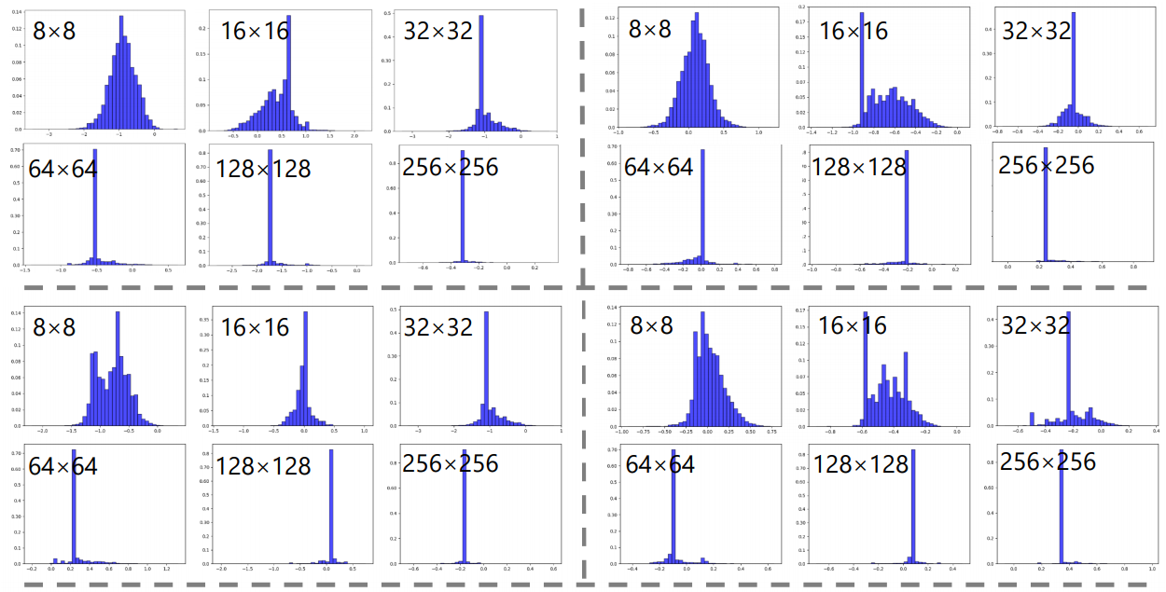
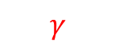
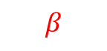
Visualization: Statistic Histogram
Center.
More obvious as input mask increase.
Different -> same (gradually, layer by layer)
$$γ$$
$$β$$
Building
Sky

Slide 10
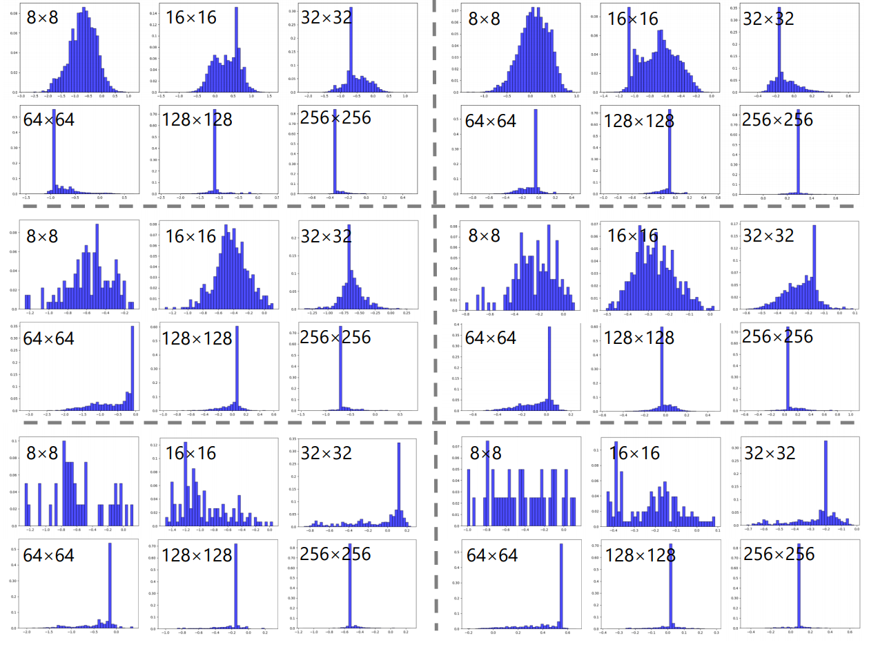
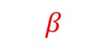
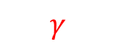
$$γ$$
$$β$$
Tree
Human
Car

Slide 11
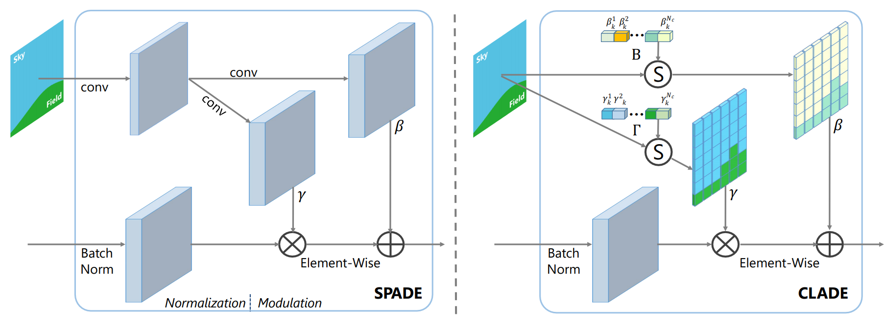
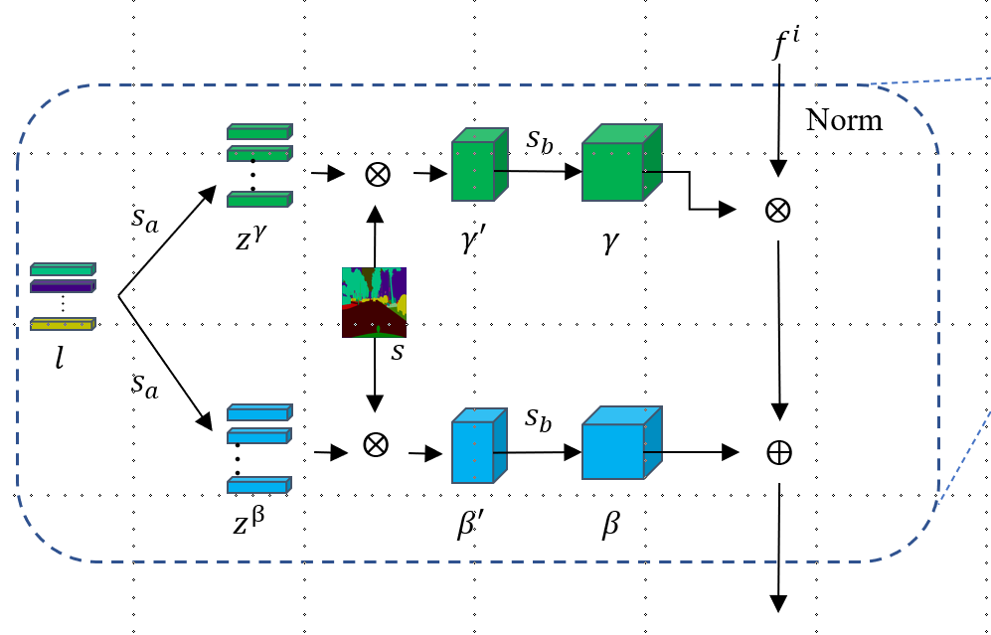
Proposed Algorithm: CLADE
Semantic-awareness vs. spatial-adaptiveness.
Guided-sampling: learn the semantic-awareness directly without conv layer.

Slide 12
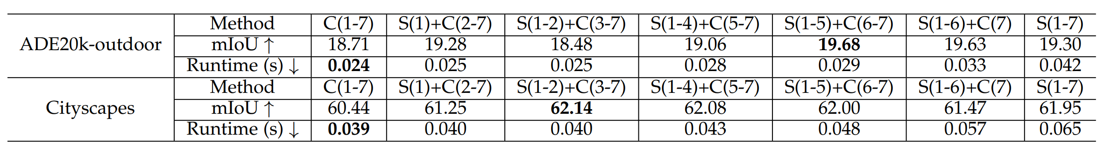
Semantic-awareness vs. spatial-adaptiveness
Low layer with SPADE, higher layer with CLADE
Why do not compare FID?

Slide 13
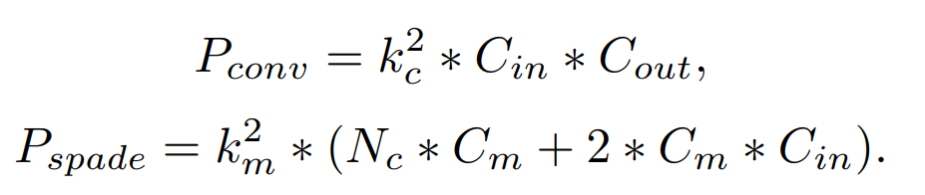
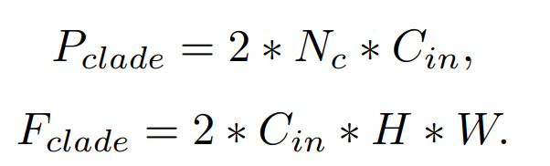
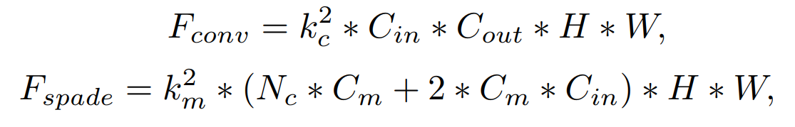
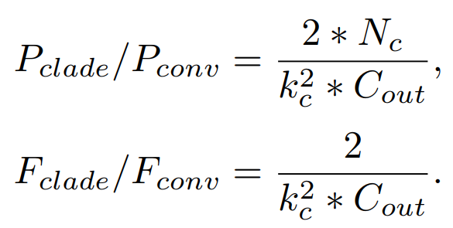
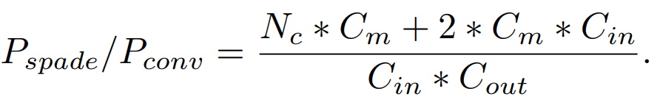
Parameter and Computation (FLOPs)

Slide 14
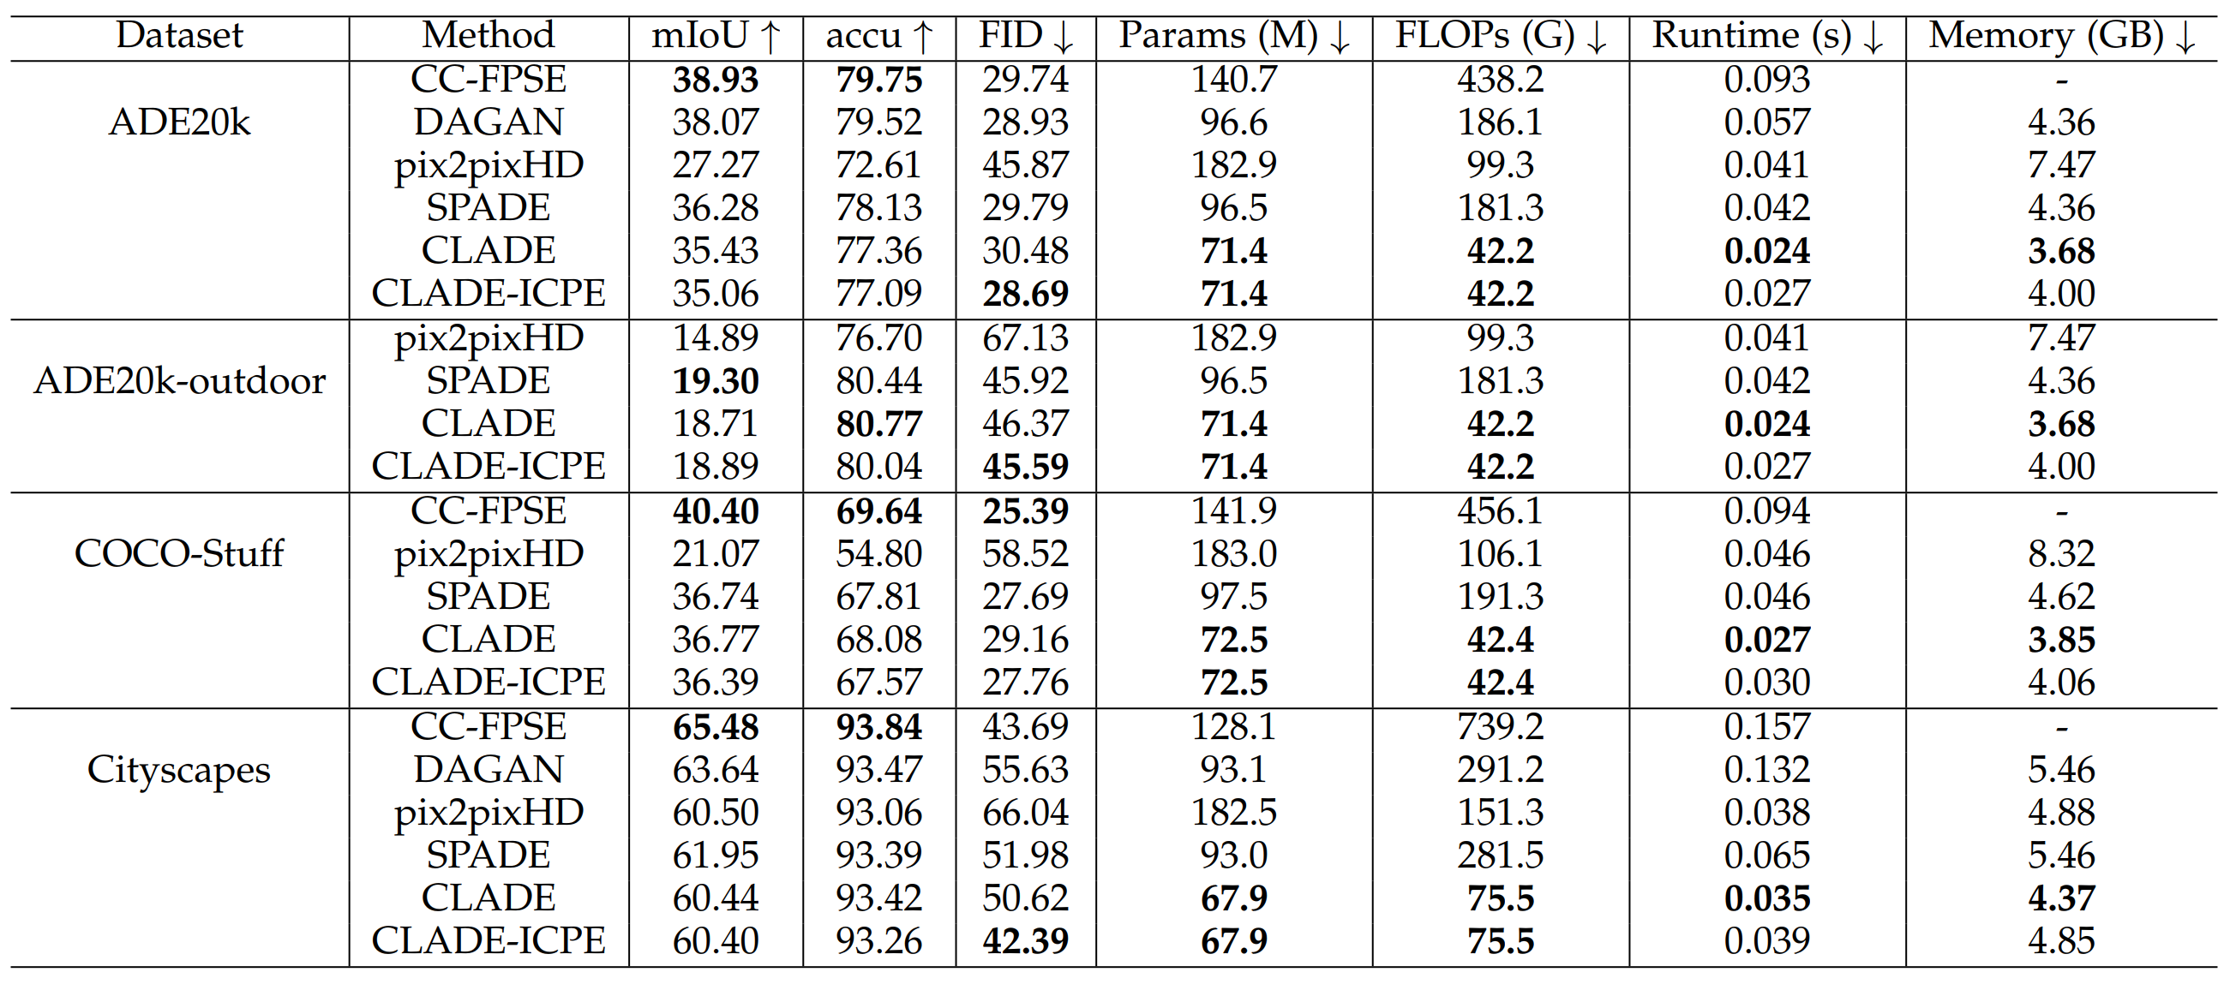
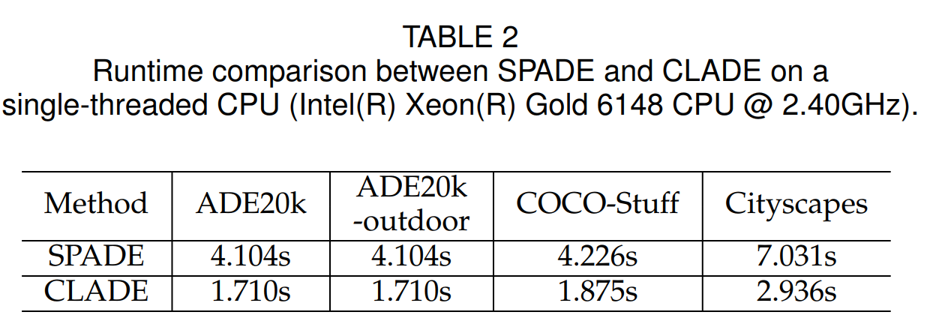

Slide 15
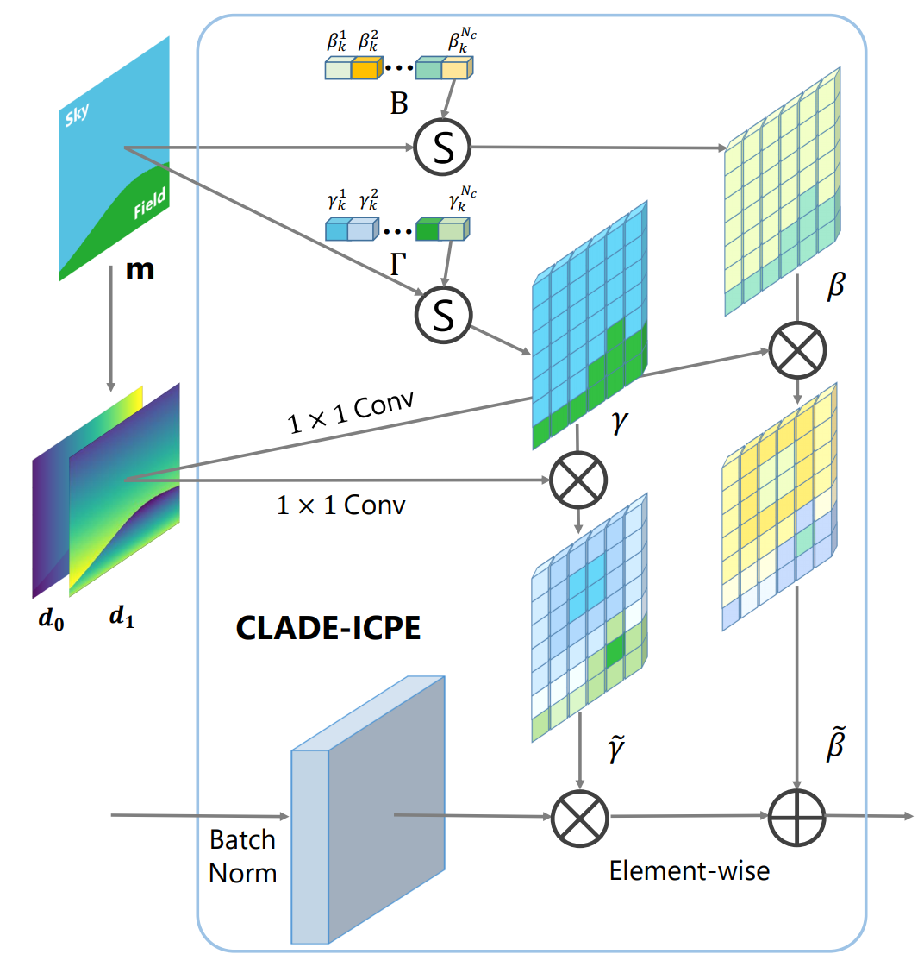
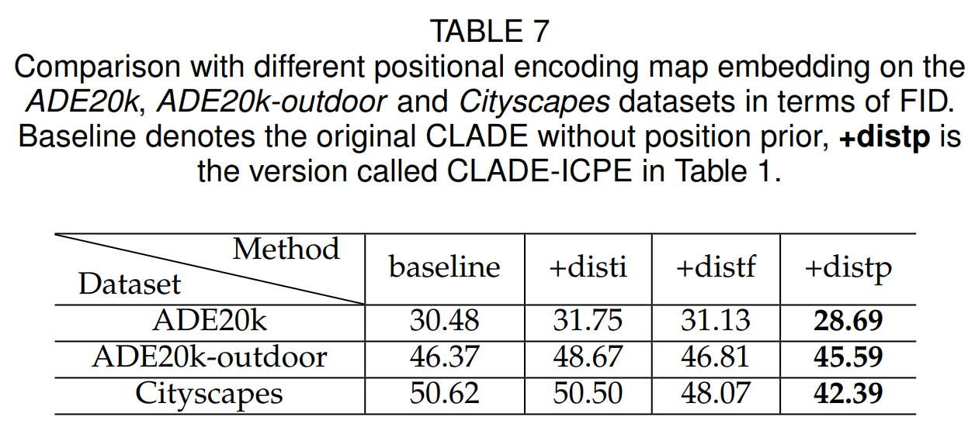
Spatially-Adaptive CLADE
Intra-class adaptiveness.
The function of this distance: make intra-class variation.
Intra-class variation is bigger in cityscapes, such as building and cars.
Sky, sea.

Slide 16
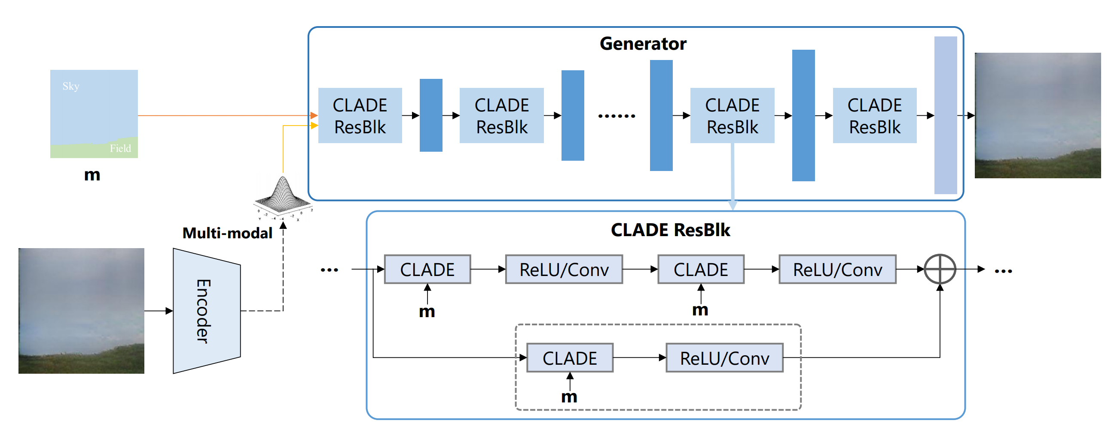
Proposed Algorithm: Multimodal for Style
Image -> encoder -> style code (VAE loss, given distribution) -> resampling -> new style code
Global style

Slide 17
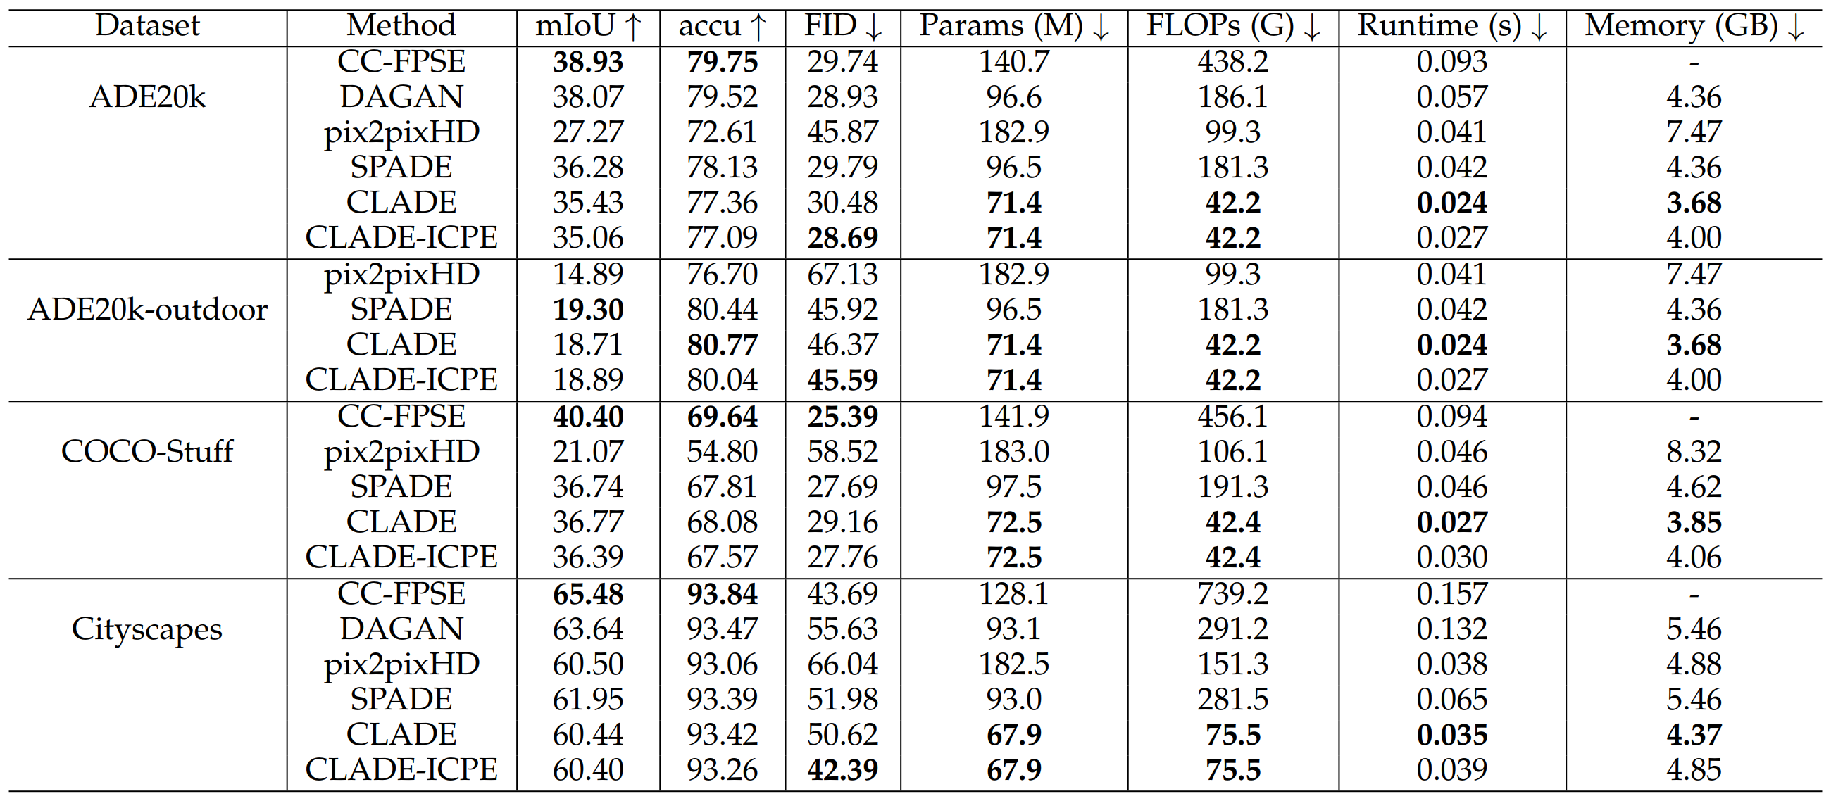
More Experiments

Slide 18
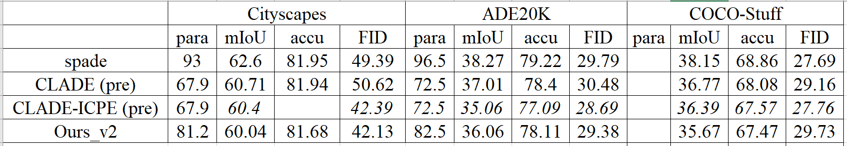

Slide 19
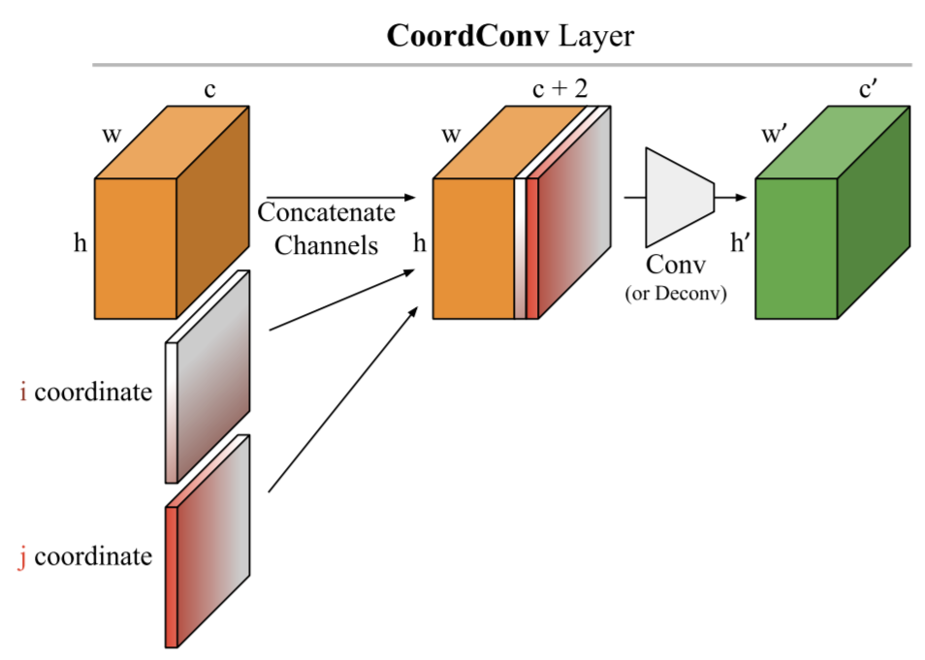
Conclusion
SPADE:
Spatial-adaptiveness
Semantic-awareness
Use new way to do almost same thing with smaller number of parameters and lower computation complexity.
One incremental improvement:
Object center position -> coordination position (coordinate convolution)
Global style -> object or instance style

